Slide 1
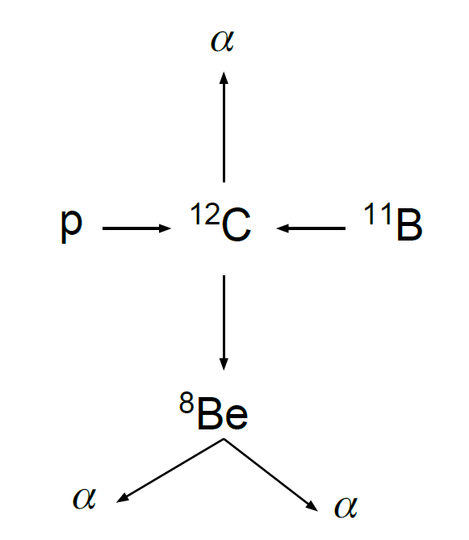
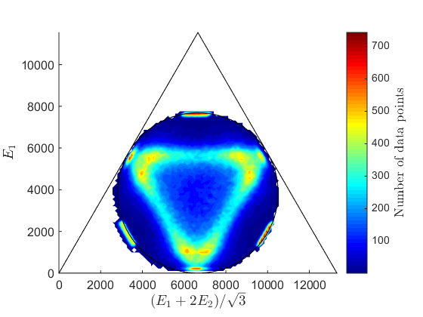
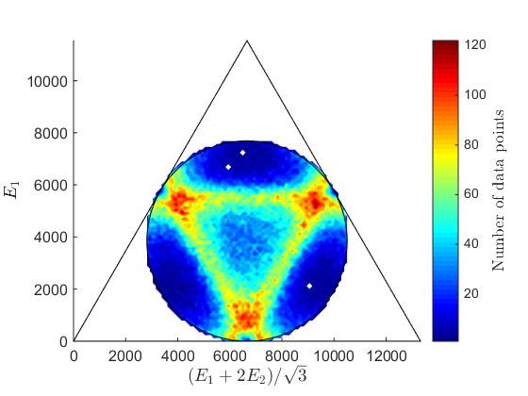
Simulation of breakup into three α particles
Notes:
My project has been about simulating the energies and directions of motions of the three alpha particles that are the product of a carbon-12 decay. The decay is modelled as sequential, making a pit stop at an excited state of Beryllium-8.

Slide 2
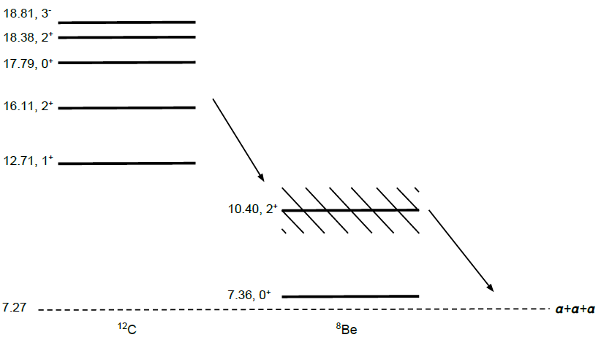
Physics set up
Notes:
We are looking specifically at these excited states of carbon-12 which can decay to beryllium-8, either in its ground state of the first excited state, under emission of an alpha. They are both unstable and can decay into a further two alphas. The first excited state of Be-8 is a resonance for this decay which means that depending on the energy of the Be-8 (which is not pre-fixed) the decay is more likely.
Not fixed energy of Be-8 !!!
We are going to look at excited states of Carbon-12 and its decay into three alpha particles through a Beryllium-8 resonance or its ground state. We wish to know the energies and directions of the alpha particles in the end state

Slide 3
The Dalitz plot
Notes:
To represent the energies we use a Dalitz plot
Triangular symmetry

Slide 4
The Dalitz plot

Slide 5
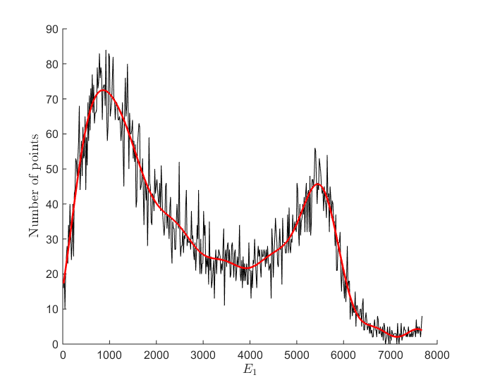
The Dalitz plot – cut along

Slide 6
Breit-Wigner distribution
Excitation energy and angle of emission are sufficient to calculate energies and momenta
Notes:
I used to different distributions or different approaches to the distributions of the energies. The first I used only briefly but I want to talk a bit about it anyway. It is relatively simple and it finds the distributions indirectly. If we look at the decay classically we find that the energies and directions are uniquely determined by just two parameters. We choose them to be the energy of the excited Be-8 and the angle of emission of the second and third alphas in the rest frame of the Be-8.

Slide 7
Breit-Wigner distribution
Energy distribution
Angle distribution
Phase space
factor
Breit-Wigner
Notes:
The energy is that of the resonant state of the Be-8 and its distribution can be approximated by this Breit-Wigner term, this is the resonant energy and this the HMFW of the peak. This factor is a phase factor that is a quantum mechanical result. It turns out that it is more likely that the alphas have high momentum, intuitively a consequence of quantization of the phase space. That the dependance is linear can be derived.
The angle distribution is also a quantum mechanical result that depends on the specific decay. This specific distribution is only for the decay of the 1+ state of C-12 at 12.71MeV.
This is fairly simple but can be developed further as for example by adding the phase factor

Slide 8
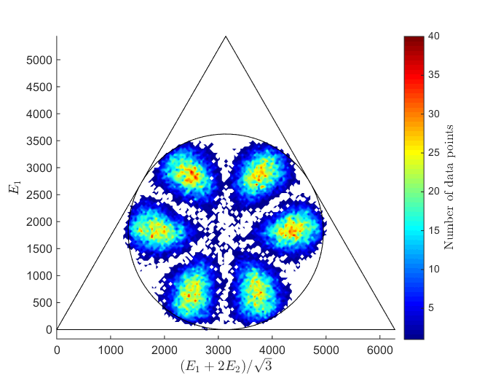
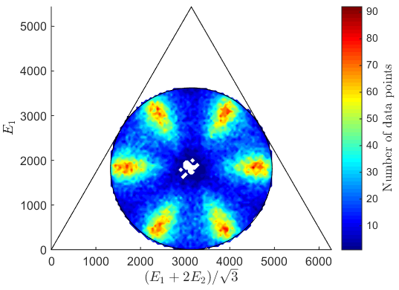
Breit-Wigner distribution
Data
Simulation
Notes:
Data and stuff

Slide 9
Schäfer
Gives probability of end state directly
Requires a plethora of parameters:
Jacobian momentum coordinates, three sets
Relative energy and reduced mass, three sets
Notes:
From an article by K. Schäfer.
A far more intricate distribution.

Slide 10
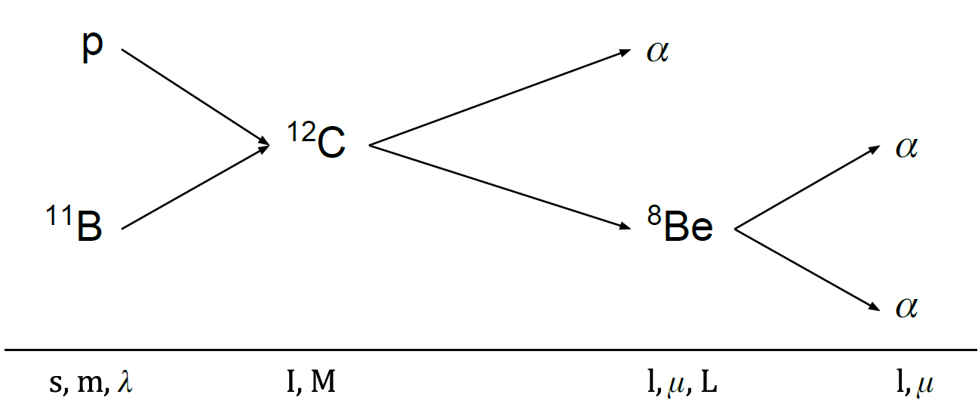
Schäfer
Quantum numbers:
Notes:
Quantum number relating the angular momenta in the process. Spins, z-components and relative angular momenta.
In our case lambda, I and l are fixed.
The possible values of these can be found through conservation of angular momentum and parity.

Slide 11
Schäfer
Shcäfer’s equation:
where
Notes:
The probability’s dependence on the energy and directions of the alpha particles.
Phase factor
We will choose which values the numbers run over.

Slide 12
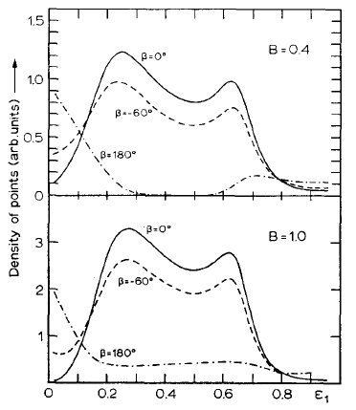
First step - confirmation

Slide 13
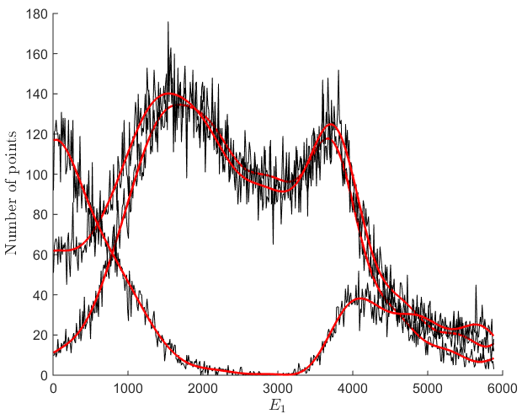
First step - confirmation

Slide 14
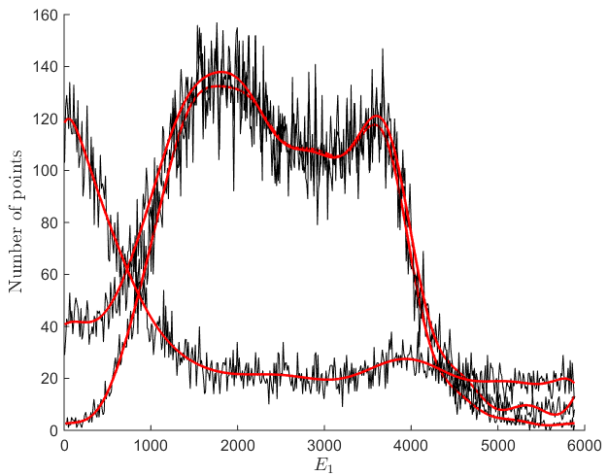
First step - confirmation

Slide 15
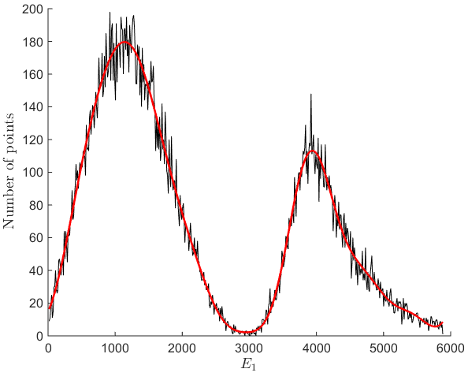
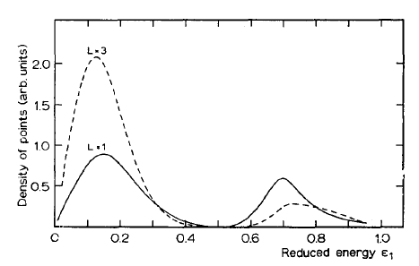
First step - confirmation

Slide 16
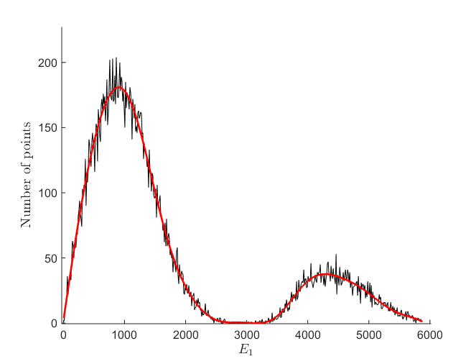
First step - confirmation

Slide 17
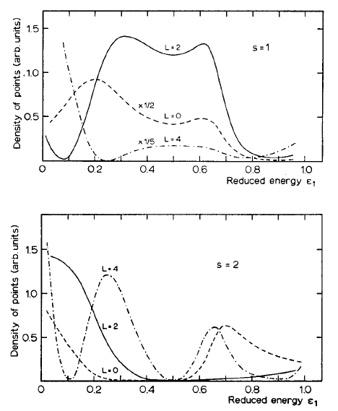
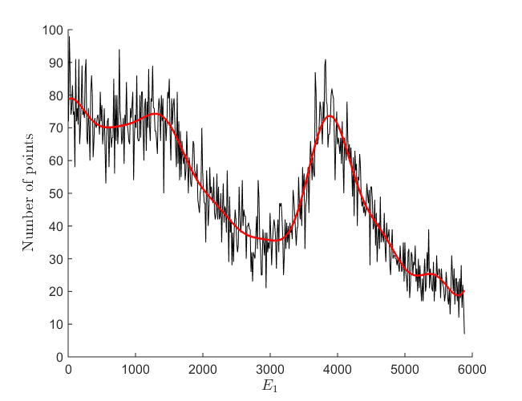
First step - confirmation

Slide 18
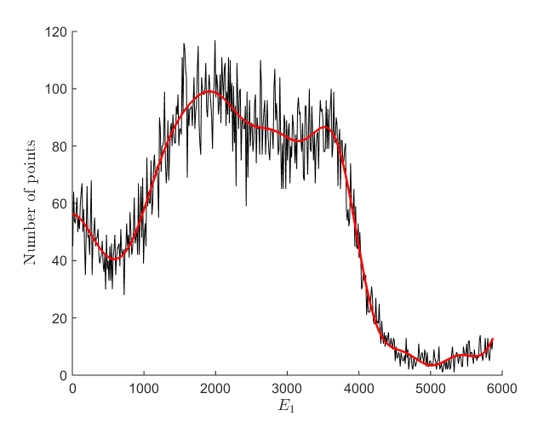
First step - confirmation

Slide 19
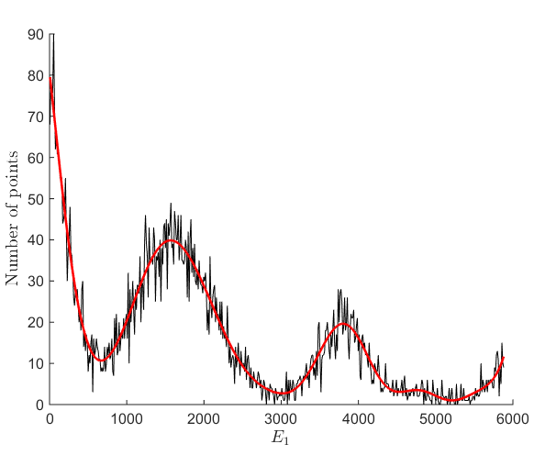
First step - confirmation

Slide 20
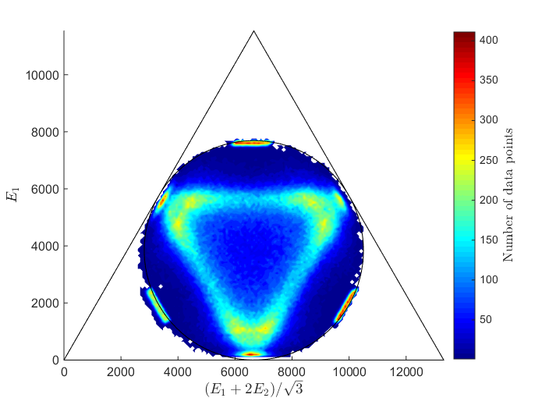
Results – comparison with data
Notes:
Be ground state, resonant energy, interference

Slide 21
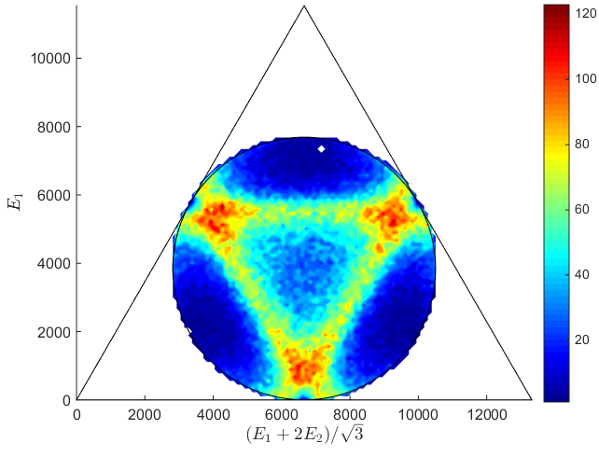
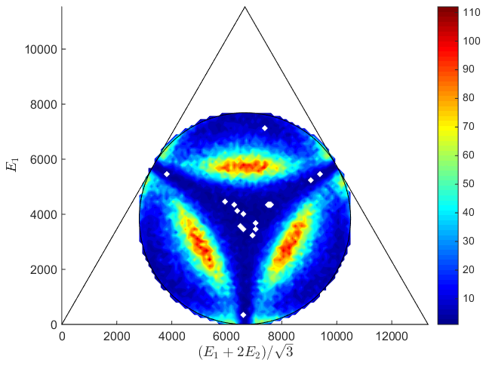
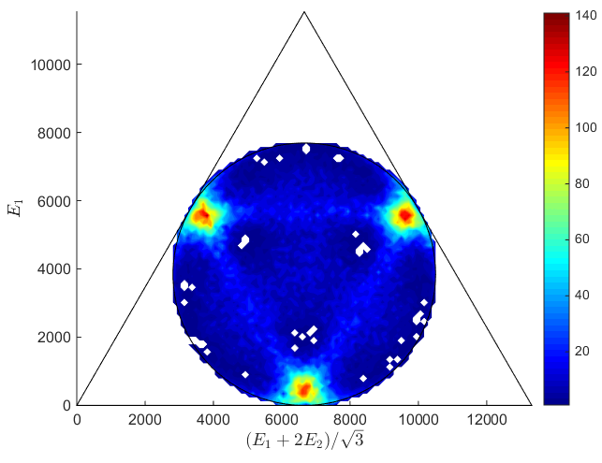
Notes:
Dominant L, interference is NOT simple summation.

Slide 22
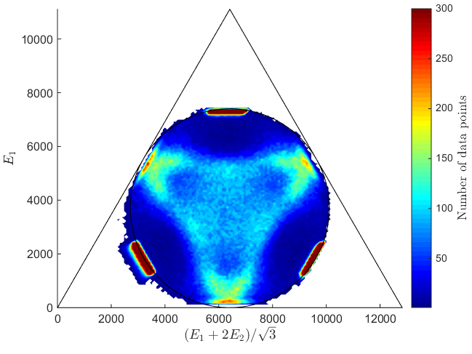
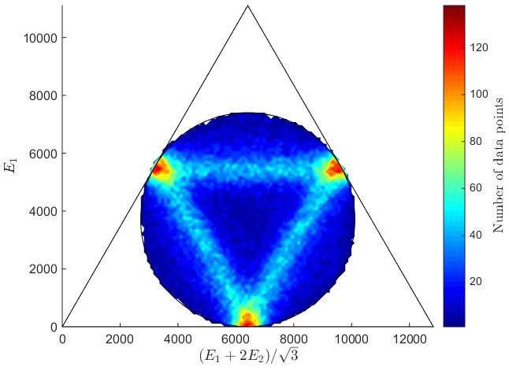
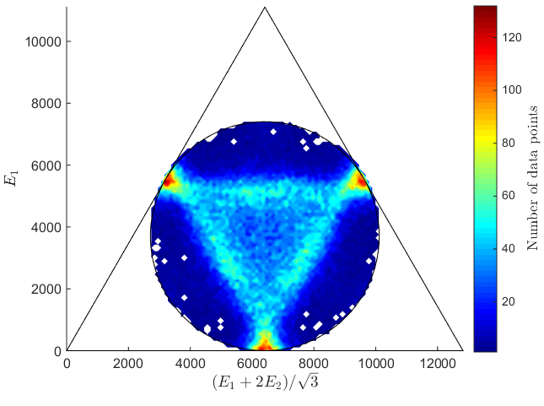
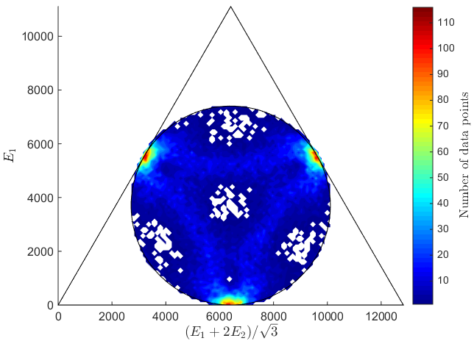

Slide 23
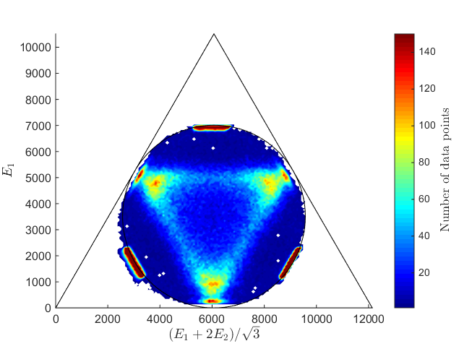
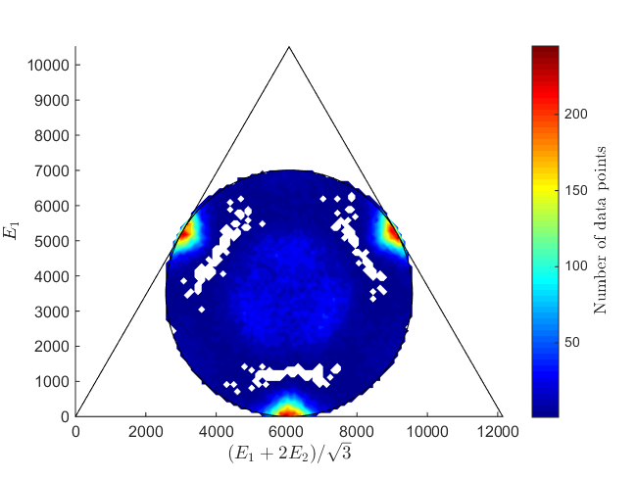
Results – comparison with data

Slide 24
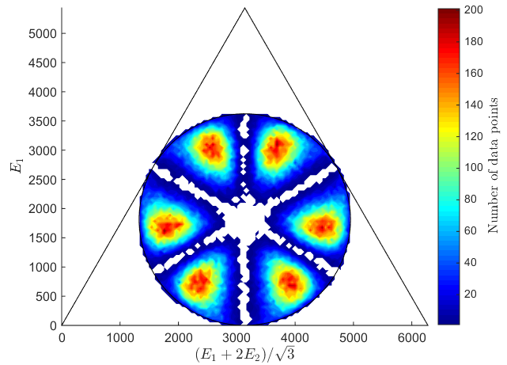
Breit-Wigner

Slide 25
In conclusion
Breit-Wigner is not completely off
Schäfer is better
Something seems to go wrong with s (!)
We should try comparing data to superpositions
And fix s…

